Slide 1
Case of the week
03/06/2020

Slide 2
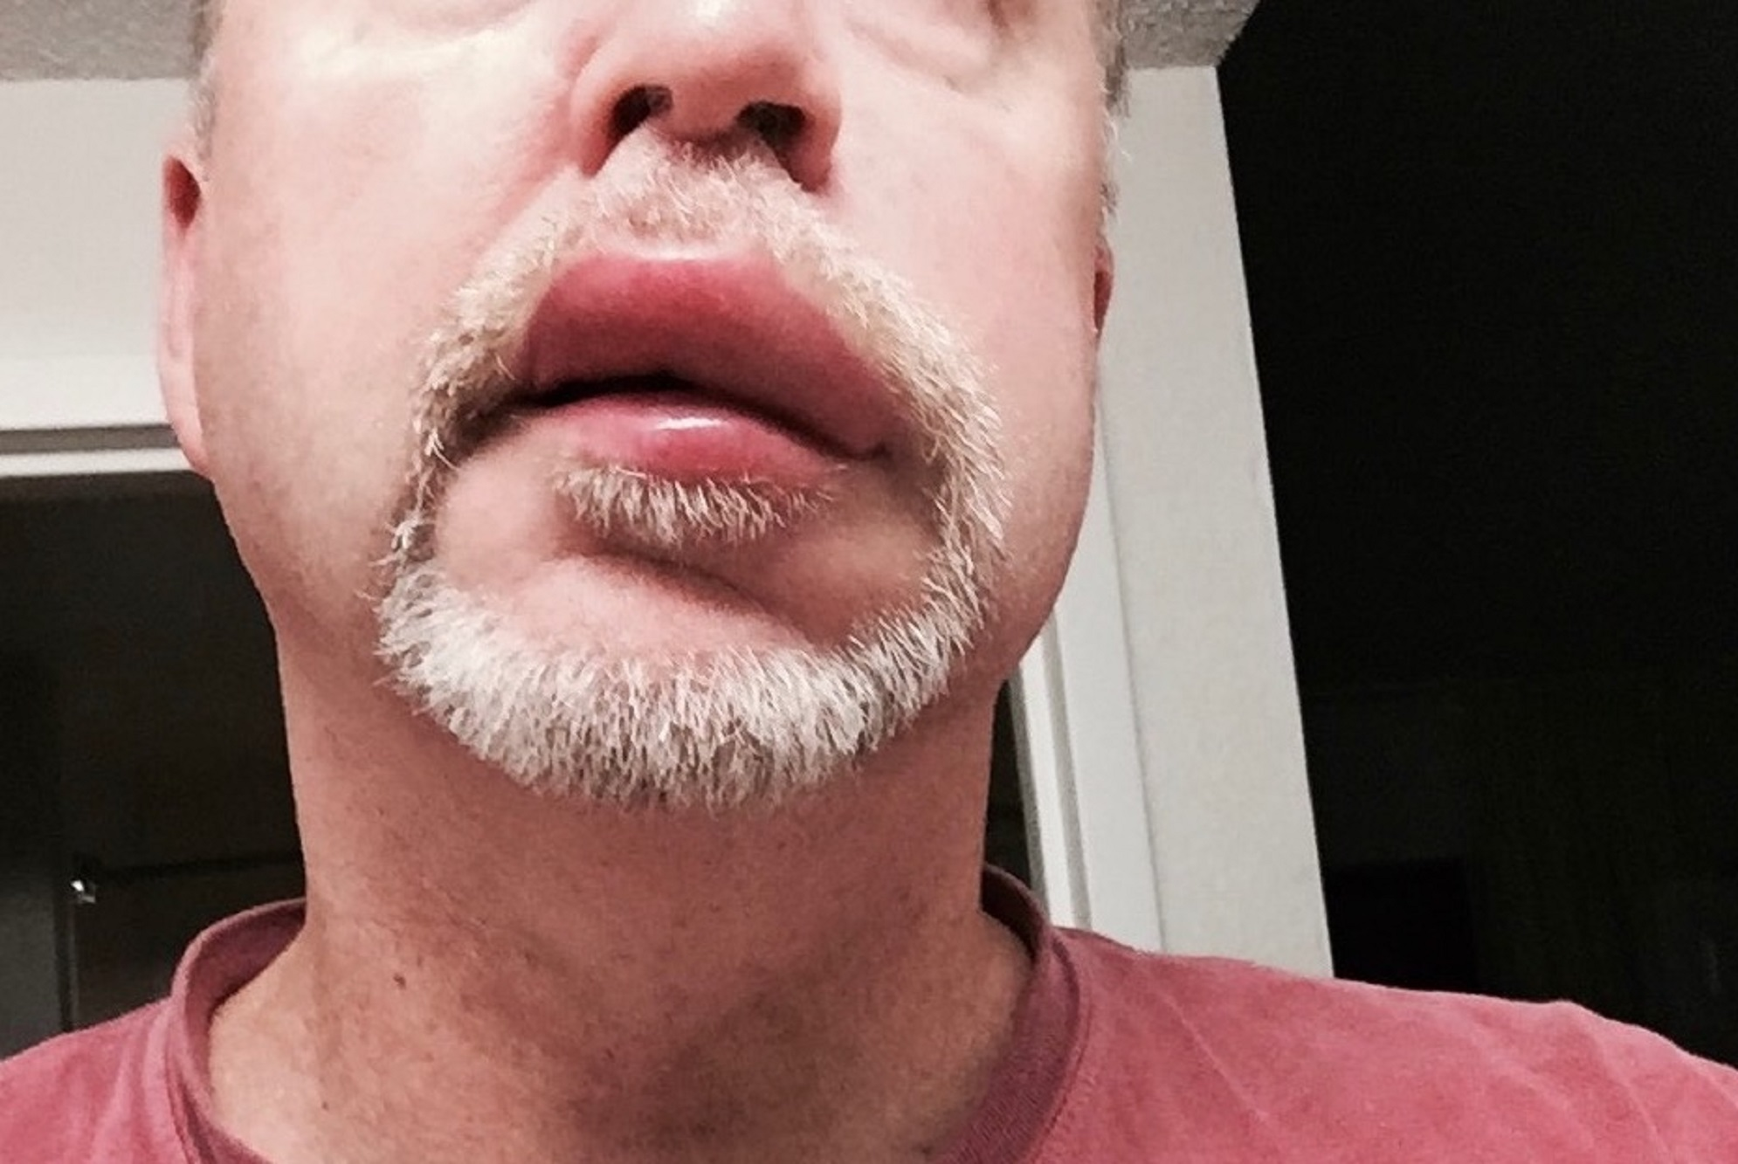
Time- 0200
A 51-year-old male with history of diabetes and hypertension presented to hospital with left facial droop, slurred speech and left sided hemiparesis. His initial CT scan was negative for acute hemorrhage. As he has no contraindication for thrombolysis the stroke team decided to treat him with tPA.
After the infusion finished patient developed left sided facial swelling.
Notes:
https://rebelem.com/tpa-associated-angioedema/

Slide 3
How will you approach this situation initially?
Notes:
Differential diagnosis-
Angioedema-
IgE mediated/ Histamine mediated- Allergic reaction to tPA
Bradykinin mediated angioedema, risk is higher if they are already on ACEI
Bleeding- hematoma- unlikely in the absence of ecchymoses
Other differential diagnosis of facial swelling is unlikely in this situation
Largest study: A total of 1135 patients were enrolled at 60 centres in all major hospitals across Canada. The registry collected data for an estimated 84% of all treated ischemic stroke patients in the country….. Symptomatic intracranial hemorrhage occurred in only 4.6% of the patients (95% confidence interval [CI] 3.4%-6.0%); however, 75% of these patients died in hospital. An additional 1.3% (95% CI 0.7%-2.2%) of patients had hemiorolingual angioedema.
Thrombolysis for Acute Ischemic Stroke: Results of the Canadian Alteplase for Stroke Effectiveness Study
Michael D Hill ¹, Alastair M Buchan, Canadian Alteplase for Stroke Effectiveness Study (CASES) Investigators
Issues-
Potential critical airway obstruction
Haemorrhagic risk which will further complicate any intervention
Approach-
Call for help- early involvement of emergency consultant on call and anaesthetics team, notification of stroke consultant
Prepare for difficult intubation- discussed in detail later
Focused assessment to ascertain the nature of the swelling- angioedema vs haemorrhage ( look for ecchymoses)
The cause of angioedema- anaphylactoid vs bradykinin mediated reaction (look for urticaria, erythema)
A- tongue, floor of mouth involvement, signs of impending upper airway obstruction- stridor, respiratory distress, excessive secretions- unable to manage
B- associated bronchospasm, air-entry
C- circulatory collapse
D- conscious state
Exposure- look for signs of allergic reaction- urticaria and erythema, other bleeding sites
2x large IV cannula
Fluids in hypotensive
Adrenaline if anaphylaxis or the cause of angioedema in not clear- IM injection
Anti histamine and Steroids (their effectiveness in anaphylaxis is a discussion for another day)
“Most of these cases of angioedema have a mild, self-limited, and benign course. While tPA is infusing, the patient should be monitored every fifteen minutes. With the development of symptoms, the infusion of tPA should stop, if not already complete”
tPA-Associated Angioedema
Matt Astin
https://rebelem.com/tpa-associated-angioedema/

Slide 4
Discuss- Angioedema
Angioedema
Causes
Histamine mediated (IgE mediated)- allergic reaction
Bradykinin mediated- ACEI, ARBs, Thrombolysis (tPA), Gliptins, Tacrolimus, Estrogen containing OCPs
Hereditary
C1 inhibitor deficiency
Normal C1 inhibitor level but mutation of other factors
Notes:
Angioedema: Classification, management and emerging therapies for the perioperative physician, 2016
Lopa Misra, Narjeet Khurmi, and Terrence L Trentman

Slide 5
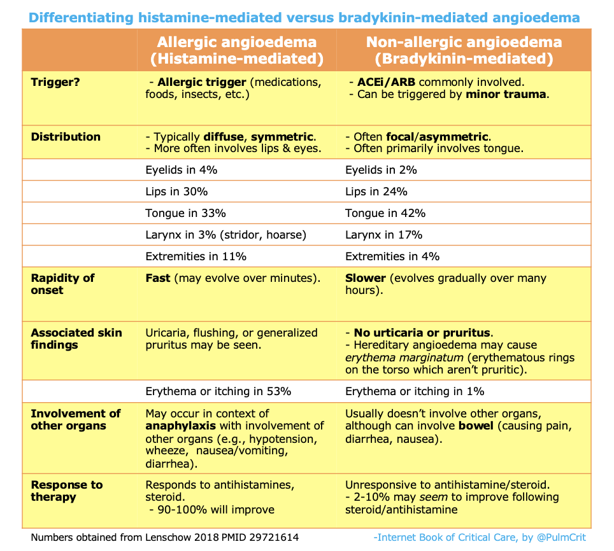
https://emcrit.org/ibcc/angioedema/
Notes:
Differentiating allergic and non-allergic angioedema

Slide 6
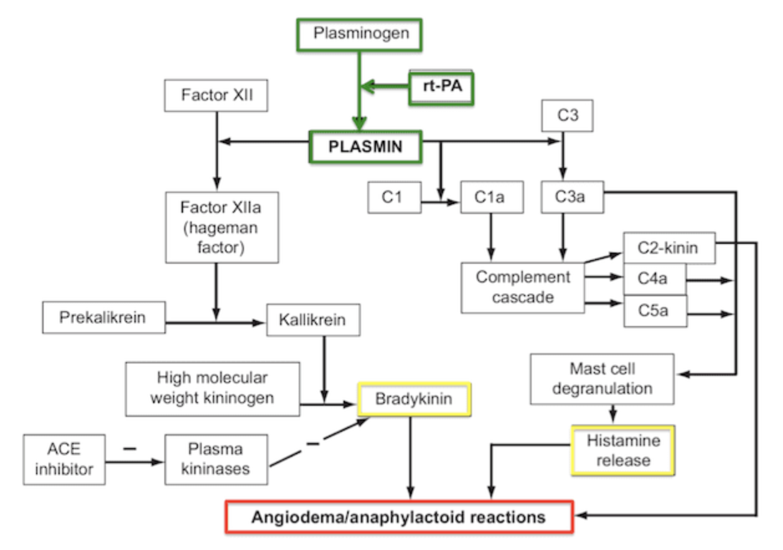
Notes:
How TPA causes angioedema- complex pathophysiology- only for reference if necessary
tPA-Associated Angioedema
Matt Astin
https://rebelem.com/tpa-associated-angioedema/

Slide 7
After initial assessment you decided to observe the patient closely for further worsening of his symptoms. He has no stridor or difficulty in breathing.
After 15 minutes you found that the patient has now developed a tongue swelling and complaining of throat tightness. Other wise his vitals are in normal limit.
What will you do now?
Notes:
Airway at risk- but patient is no crashing
Patient may need intubation soon
Involve anesthetics and ENT if not already done.
IM adrenaline/ Nebulized adrenaline (theoretical risk of increased intracranial bleeding- but safe to be administered according to recent evidences)
Angioedema After tPA: What Neurointensivists Should Know, 2012
Jennifer E Fugate ¹, Ejaaz A Kalimullah, Eelco F M Wijdicks
Awake double set up intubation- (https://emcrit.org/ibcc/angioedema/)
Fiber optic intubation in the theatre in awake patient will be ideal in this situation.
Front of neck access to be prepared and be ready at the same time (significant bleeding risk as patient is post thrombolysis- nightmare situation)
Other drugs to consider- discuss with immunologist
Tranexamic acid- used for several years for hereditary or bradykinin mediated angioedema, contraindicated in this scenario as patient has stroke
FFP- reasonable agent to use but may worsens symptoms
Icatibant- recent evidences are not very promising
C1 INH concentrate (Berinert)
“The use of C1 esterase inhibitor and selective bradykinin inhibitor (icatibant) in tPA-induced angioedema refractory to conservative medical treatment has shown some promise”
Angioedema: A Life-threatening Complication of Tissue Plasminogen Activator
Monitoring Editor: Alexander Muacevic and John R Adler
Muhammad Khalid,¹ Majd Kanaa,¹ Yazan Alkawaleet,¹ and Muhammad Talha Ayub²

Slide 8
References and further reading
Angioedema, 2019, Josh Farkas, https://emcrit.org/ibcc/angioedema/
tPA-Associated Angioedema, Matt Astin, https://rebelem.com/tpa-associated-angioedema/
Thrombolysis for Acute Ischemic Stroke: Results of the Canadian Alteplase for Stroke Effectiveness Study, Michael D Hill ¹, Alastair M Buchan, Canadian Alteplase for Stroke Effectiveness Study (CASES) Investigators
Angioedema: Classification, management and emerging therapies for the perioperative physician, 2016
Lopa Misra, Narjeet Khurmi, and Terrence L Trentman

Slide 9
References and further reading
Angioedema After tPA: What Neurointensivists Should Know, 2012, Jennifer E Fugate ¹, Ejaaz A Kalimullah, Eelco F M Wijdicks
Angioedema: A Life-threatening Complication of Tissue Plasminogen Activator, Monitoring Editor: Alexander Muacevic and John R Adler, Muhammad Khalid,¹ Majd Kanaa,¹ Yazan, Alkawaleet,¹ and Muhammad Talha Ayub²
https://litfl.com/angioedema/
https://www.allergy.org.au/patients/skin-allergy/angioedema

