Slide 1
Case of the week
15/07/2020

Slide 2
A 35 year old man presented to ED with a history of palpitation for last one hour, he is pale, sweaty and feeling dizzy.
His initial vitals are-
BP- 80/50, Sats- 98% RA, GCS 15

Slide 3
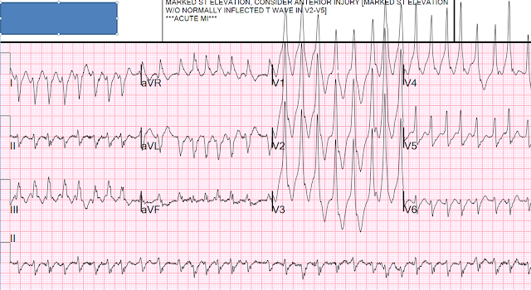
Interpret the ECG
Notes:
1. The rhythm is irregularly irregular, therefore it is atrial fibrillation 2. The complexes are wide (so one might think of atrial fibrillation with aberrancy, in which case you should see RBBB or LBBB pattern, which is not there) 3. It is very fast (200 bpm) 4. The shortest R-R interval (between complexes 12 and 13) is about 240 ms (very short) 5. The complexes look bizarre and are not uniform, as they would be with simple aberrancy. Thus, these represent differentially pre-excited ventricular myocardium.
http://hqmeded-ecg.blogspot.com/2013/03/wide-complex-tachycardia.html

Slide 4
Discuss the significance of Pre-excitation syndromes in emergency department.
Notes:
Pre-Excitation and Accessory Pathways-
Pre-excitation refers to early activation of the ventricles due to impulses bypassing the AV node via an accessory pathway.
An accessory pathway can conduct impulses either anterograde, towards the ventricle, retrograde, away from the ventricle, or in both directions.
In WPW the accessory pathway is often referred to as the Bundle of Kent, or atrioventricular bypass tract.
The direction of conduction affects the appearance of the ECG in sinus rhythm and during tachyarrhythmia's.
Tachyarrhythmia can be facilitated by the formation of a reentry circuit involving the accessory pathway, termed atrioventricular reentry tachycardia's (AVRT).
https://litfl.com/pre-excitation-syndromes-ecg-library/

Slide 5
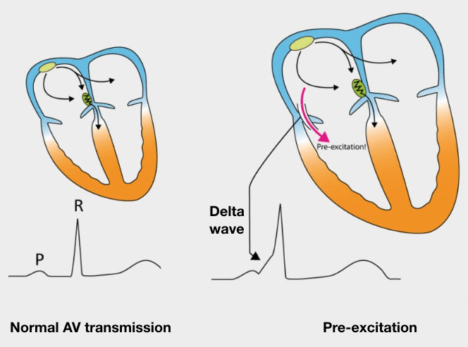
ECG features of WPW in sinus rhythm
PR interval <120ms
Delta wave – slurring slow rise of initial portion of the QRS
QRS prolongation >110ms
ST Segment and T wave discordant changes – i.e. in the opposite direction to the major component of the QRS complex
Pseudo-infarction pattern can be seen in up to 70% of patients – due to negatively deflected delta waves in the inferior / anterior leads (“pseudo-Q waves”), or as a prominent R wave in V1-3 (mimicking posterior infarction).
Notes:
https://litfl.com/pre-excitation-syndromes-ecg-library/

Slide 6
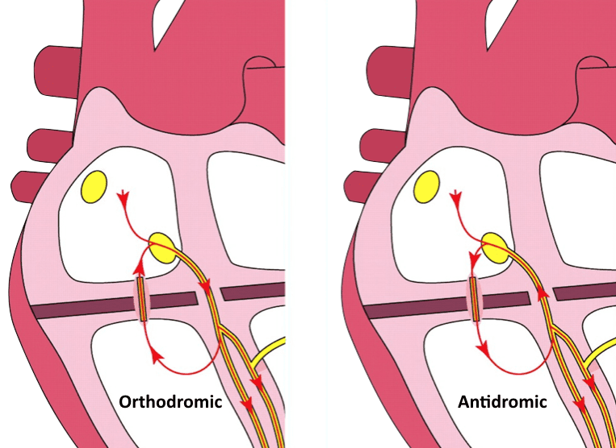
Atrioventricular Reentry Tachycardias (AVRT)
ECG features- Orthodromic
Rate 200- 300
Narrow QRS complex <120 m sec
P waves are buried in QRS or retrograde
QRS alternans
T wave inversion and ST depression are common
ECG features- Antedromic
Rate 200- 300
Wide QRS complexes
Notes:
How do we treat them?
Hemodynamically unstable- DC cardioversion in both situation
For orthrodromic conduction AVRT- treatment is same as SVT
For antedromic conduction- stable patients may respond to drug therapy including amiodarone, procainamide or ibutilide, but may require DC cardioversion
The differentiation between VT and SVT with aberrancy has not discussed in this presentation. Please find the link below for further discussion on that topic.
https://litfl.com/vt-versus-svt-ecg-library/

Slide 7
Atrial fibrillation with WPW
Atrial fibrillation can occur in up to 20% of patients with WPW.
ECG features-
Rate >200
Irregularly irregular
Wide QRS complexes, variable shape and morphology
Axis remains same as oppose to polymorphic VT
Rapid ventricular rates may result in degeneration to VT or VF.
Notes:
https://litfl.com/pre-excitation-syndromes-ecg-library/

Slide 8
So, how do we manage our patient?
Notes:
The main issue is-
Any AV nodal blocking agent, adenosine, beta blockers and calcium channel blockers, may increase the conduction via the accessory pathway resulting in VT, VF. So those agents are contraindicated.
In a hemodynamically unstable patient urgent synchronized DC cardioversion is required.
Medical treatment options in a stable patient include procainamide or ibutilide, although DC cardioversion may be preferred.
Hemodynamically unstable patient procedural sedation can be challenging
Procedural sedation-
Traditional sedation with Propofol can further lower the blood pressure
Options- IV Fentanyl and midazolam or IV ketamine sedation
Cardioversion- synchronised DC cardioversion
Further explanation-
https://www.youtube.com/watch?v=qrhWH2_KKOY

Slide 9
References-
http://hqmeded-ecg.blogspot.com/2013/03/wide-complex-tachycardia.html
https://litfl.com/ecg-case-112/
https://litfl.com/pre-excitation-syndromes-ecg-library/
https://www.youtube.com/watch?v=qrhWH2_KKOY
https://litfl.com/vt-versus-svt-ecg-library/

