Slide 1
Case of the week
30/09/2020

Slide 2
A 25-year-old man presented to the emergency department after a motorbike accident on the freeway. On the scene, his blood pressure was 90 systolic, HR 110. He is in spinal precaution and is significantly distressed due to pain.
During his assessment, a pelvic X-ray was obtained.

Slide 3
Interpret the Xray
www.healio.com/orthopedics/journals/ortho
Notes:
Interpretation-
Fracture involving left sacroiliac joint and left pubic rami, with superior displacement of the lateral fragment
Class- vertical sheer fracture (Young Burgess Classification)
Unstable fracture potential life-threatening bleed, can be associated with urethral and bladder injury.

Slide 4
How do you classify pelvic fractures?
Notes:
Classification-
Young-Burgess Classification
Antero posterior
Lateral compression
Vertical sheer
See the image in next page.
Tile classification
A: stable
A1: fracture not involving the ring (avulsion or iliac wing fracture)
A2: stable or minimally displaced fracture of the ring
A3: transverse sacral fracture (Denis zone III sacral fracture)
B: rotationally unstable, vertically stable
B1: open book injury (external rotation)
B2: lateral compression injury (internal rotation)
B2-1: with anterior ring rotation/displacement through ipsilateral rami
B2-2-with anterior ring rotation/displacement through contralateral rami (bucket-handle injury)
B3: bilateral
C: rotationally and vertically unstable
C1: unilateral
C1-1: iliac fracture
C1-2: sacroiliac fracture-dislocation
C1-3: sacral fracture
C2: bilateral with one side type B and one side type C
C3: bilateral with both sides type C

Slide 5
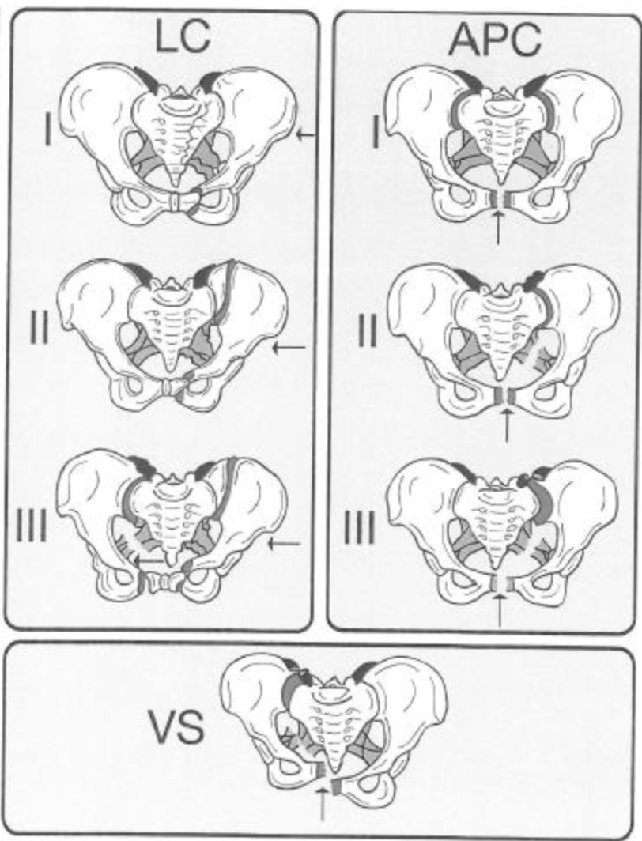
Notes:
The picture of the right demonstrates the force vector for the type of fracture

Slide 6
What other important injuries are associated with pelvic fracture?
Notes:
Vascular injury-
Arterial injury- most common
Internal pudendal anteriorly
Gluteal posteriorly
Venous injury-
Ilio-lumber vein up to 60% of cases
Bladder and urethral injury (5-20%)
posterior urethra with pelvic fractures
anterior urethra with straddle injuries
Intra-abdominal injury
spleen and liver (12%)
bowel (4%)
About 5% of pelvic fractures are open and may involve rectal or vaginal tears

Slide 7
What are the important features of your assessment?
Notes:
The goals of assessment in patients with pelvic injuries are:
Identification of life-threatening haemorrhage (both pelvic and non-pelvic)
Identification of associated injuries-
Bladder
Bowel
Genitalia
History & Examination
Mechanism of injury with focus on directional forces to pelvis
Haemodynamic parameters to quantify extent of haemorrhage
Inspection for bruising, deformity and compound wounds.
Gently palpate the skeletal structures – ‘springing’ the pelvis is not advised as it can
potentially exacerbate haemorrhage
Examine lower limbs for length discrepancy, ischaemia or neurology
Abdominal examination for signs of peritonism
PR / PV for evidence of bowel / genital injury which would indicate a compound injury
MINIMISE unnecessary patient movement so to avoid disruption of clot formation
Investigations
Bedside:
VBG
FAST
Bloods:
FBC, UEs LFT, lipase Coags G&H & CXM ROTEM
Imaging:
Lateral cervical
Chest Pelvic XRay
CT- CTA- further discussed.

Slide 8
You have activated a hospital trauma response team
Lab has been notified for activation of critical bleeding protocol.
His Current vitals are-
HR 110
BP 100/60
Sats 96%
His CXR is unremarkable.
Fast scan negative and no significant head or spinal injury found so far on clinical examination
How will you approach the situation now?
Notes:
Goals of management:
Address hypovolaemia and hypoperfusion from both pelvic and non-pelvic sources
Expedite definitive therapy for haemostasis
Address associated bladder, bowel or genital injuries
Co-ordinate with State trauma unit
Approach
Application of pelvic splinting
Pelvic binder-
Has definite role in APC fractures
Can have deleterious affect in LC fractures
Effect of Early Pelvic Binder Use in the Emergency Management of Suspected Pelvic Trauma: A Retrospective Cohort Study
Sheng-Der Hsu,^{1,*} Cheng-Jueng Chen,² Yu-Ching Chou,³ Sheng-Hao Wang,⁴ and De-Chuan Chan²
Conclusion-
Because of the ease of application, relatively inexpensive cost, low potential for complications, and benefit to pelvic stability, we recommend the early use of a pelvic binder if pelvic injury is suspected before definitive imaging is available, in the same way as a cervical spine collar is used to protect the cervical spine from further injury prior to the definitive identification and characterization of an injury.
Continue homeostatic resuscitation with blood products and tranexamic acid. Correct coagulation abnormality as per ROTEM.
Aim for- MAP>60
Supportive therapy- Analgesics
Further assessment with CT with angiogram- to determine the extent of injury and identify the culprit vessel. But the transfer of the patient to the tertiary trauma centre should not be delayed.
Definitive therapy-
Liaise with Trauma team at State trauma unit for urgent transfer- for interventional radiology in the presence of trauma team to embolise the bleeding vessels.
If the patient become hemodynamically unstable or delay in IR- damage control laparotomy and packing of the pelvis- then to IR

Slide 9
Notes:
Pelvic trauma pathway at SCGH

Slide 10
References and Resources
www.emergpa.net
www.litfl.com
http://www.emdocs.net/pelvic-fractures-ed-presentations-management/
https://emcrit.org/emcrit/severe-pelvic-trauma/

