Slide 1
Case of the week
07/10/2020

Slide 2
An 18-year-old Sudanese man presents to ED with a penile erection for the last 6 hours. He woke up with an erection at 6 am but was too embarrassed to tell anyone about it.
He decided to come to hospital when pain was unbearable.
What are the important features of your assessment?
Notes:
Issues-
Ischemic/ Low flow priapism- risk of impotence,
Starts at 4 hours
>24 hours 50%
>72 hours 100%
History-
Onset
Penile discharge, scrotal edema
Associated symptoms
Previous episodes
Trauma
PMHx- Blood dyscrasias- sickle cell disease/ hematological malignancy, spinal cord issues
Drug use- Sildenafil, Papavarin use, CCBs, antipsychotics, illicit drug use- stimulants
Family history
Examination-
Penile and scrotal examination
Abdominal examination

Slide 3
Discuss types and causes of priapism.
Notes:
Low flow or ischemic
High flow
Stuttering- recurrent ischemic from underlying pathology

Slide 4
Ischaemic (Low flow) | High flow
Most of them are caused by- Hematological Idiopathic Impotence treatment medications Drug induced- sildenafil, tadalafil, intracavernosal papaverin inj. Stimulants Antipsychotics Prazocin and hydralizine Haematological condition- Sickle cell disease Haematological malignancies Procoagulant states Others- Spinal cord disease Vasculitis | Unregulated cavernosal blood flow Traumatic arterio venous fistula

Slide 5
How will you differentiate high flow and low flow priapism?
Notes:
Historical features
Clinical exam-
High flow- Typically painless, not fully tumescent
Low flow- Painful, fully tumescent with corpus cavernosa rigidity without involvement of corpus spongiosum and glans penis
VBG of the cavernosal blood sample-
High flow- PO2 > 90 mmHg, PCO2 <40 mmHg, pH ~ 7.40
Blood flow observed (turbulence), compression sign
Low flow- PO2 <30 mmHg, PCO2 >60 mmHg, pH <7.25

Slide 6
Assessment findings-
6 hours of priapism, first episode
Nausea no vomiting
No penile discharge or scrotal pain
No drug history
Known history of sickle cell disease
How will you manage his priapism?
Notes:
Analgesics
High flow oxygen
IV hydration- normal saline
Management of priapism-
Pseudoephedrine PO 60mg 2 tablets
Contraindication- uncontrolled hypertension
Aspiration-
Dorsal penile block- 2’o clock and 10’o clock position
Green butterfly needle aspirate 20-30 mis
Irrigation with normal saline-
10 mls of normal saline 10 aliquots
May not be effective, questionable benefits
Vasoconstrictor injection-
Adrenaline 1ml 1:100,000 mixed in 10 mis of normal saline
80% success rate
Referral to hematologist/ Urologist- surgical management

Slide 7
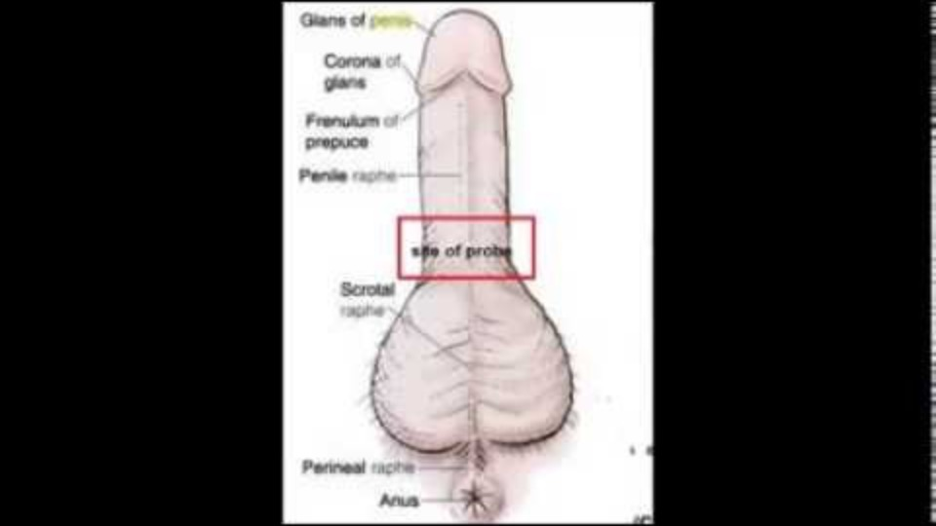
https://coreem.net/core/priapism/
Notes:
Dorsal penile block

Slide 8
References and resources
http://www.emdocs.net/priapism-ed-pearls-pitfalls/
https://coreem.net/core/priapism/
https://www.ncbi.nlm.nih.gov/pmc/articles/PMC4236300/
https://www.cochranelibrary.com/cdsr/doi/10.1002/14651858.CD004198.pub3/full?cookiesEnabled
https://www.ncbi.nlm.nih.gov/pmc/articles/PMC3253142/

