Slide 1
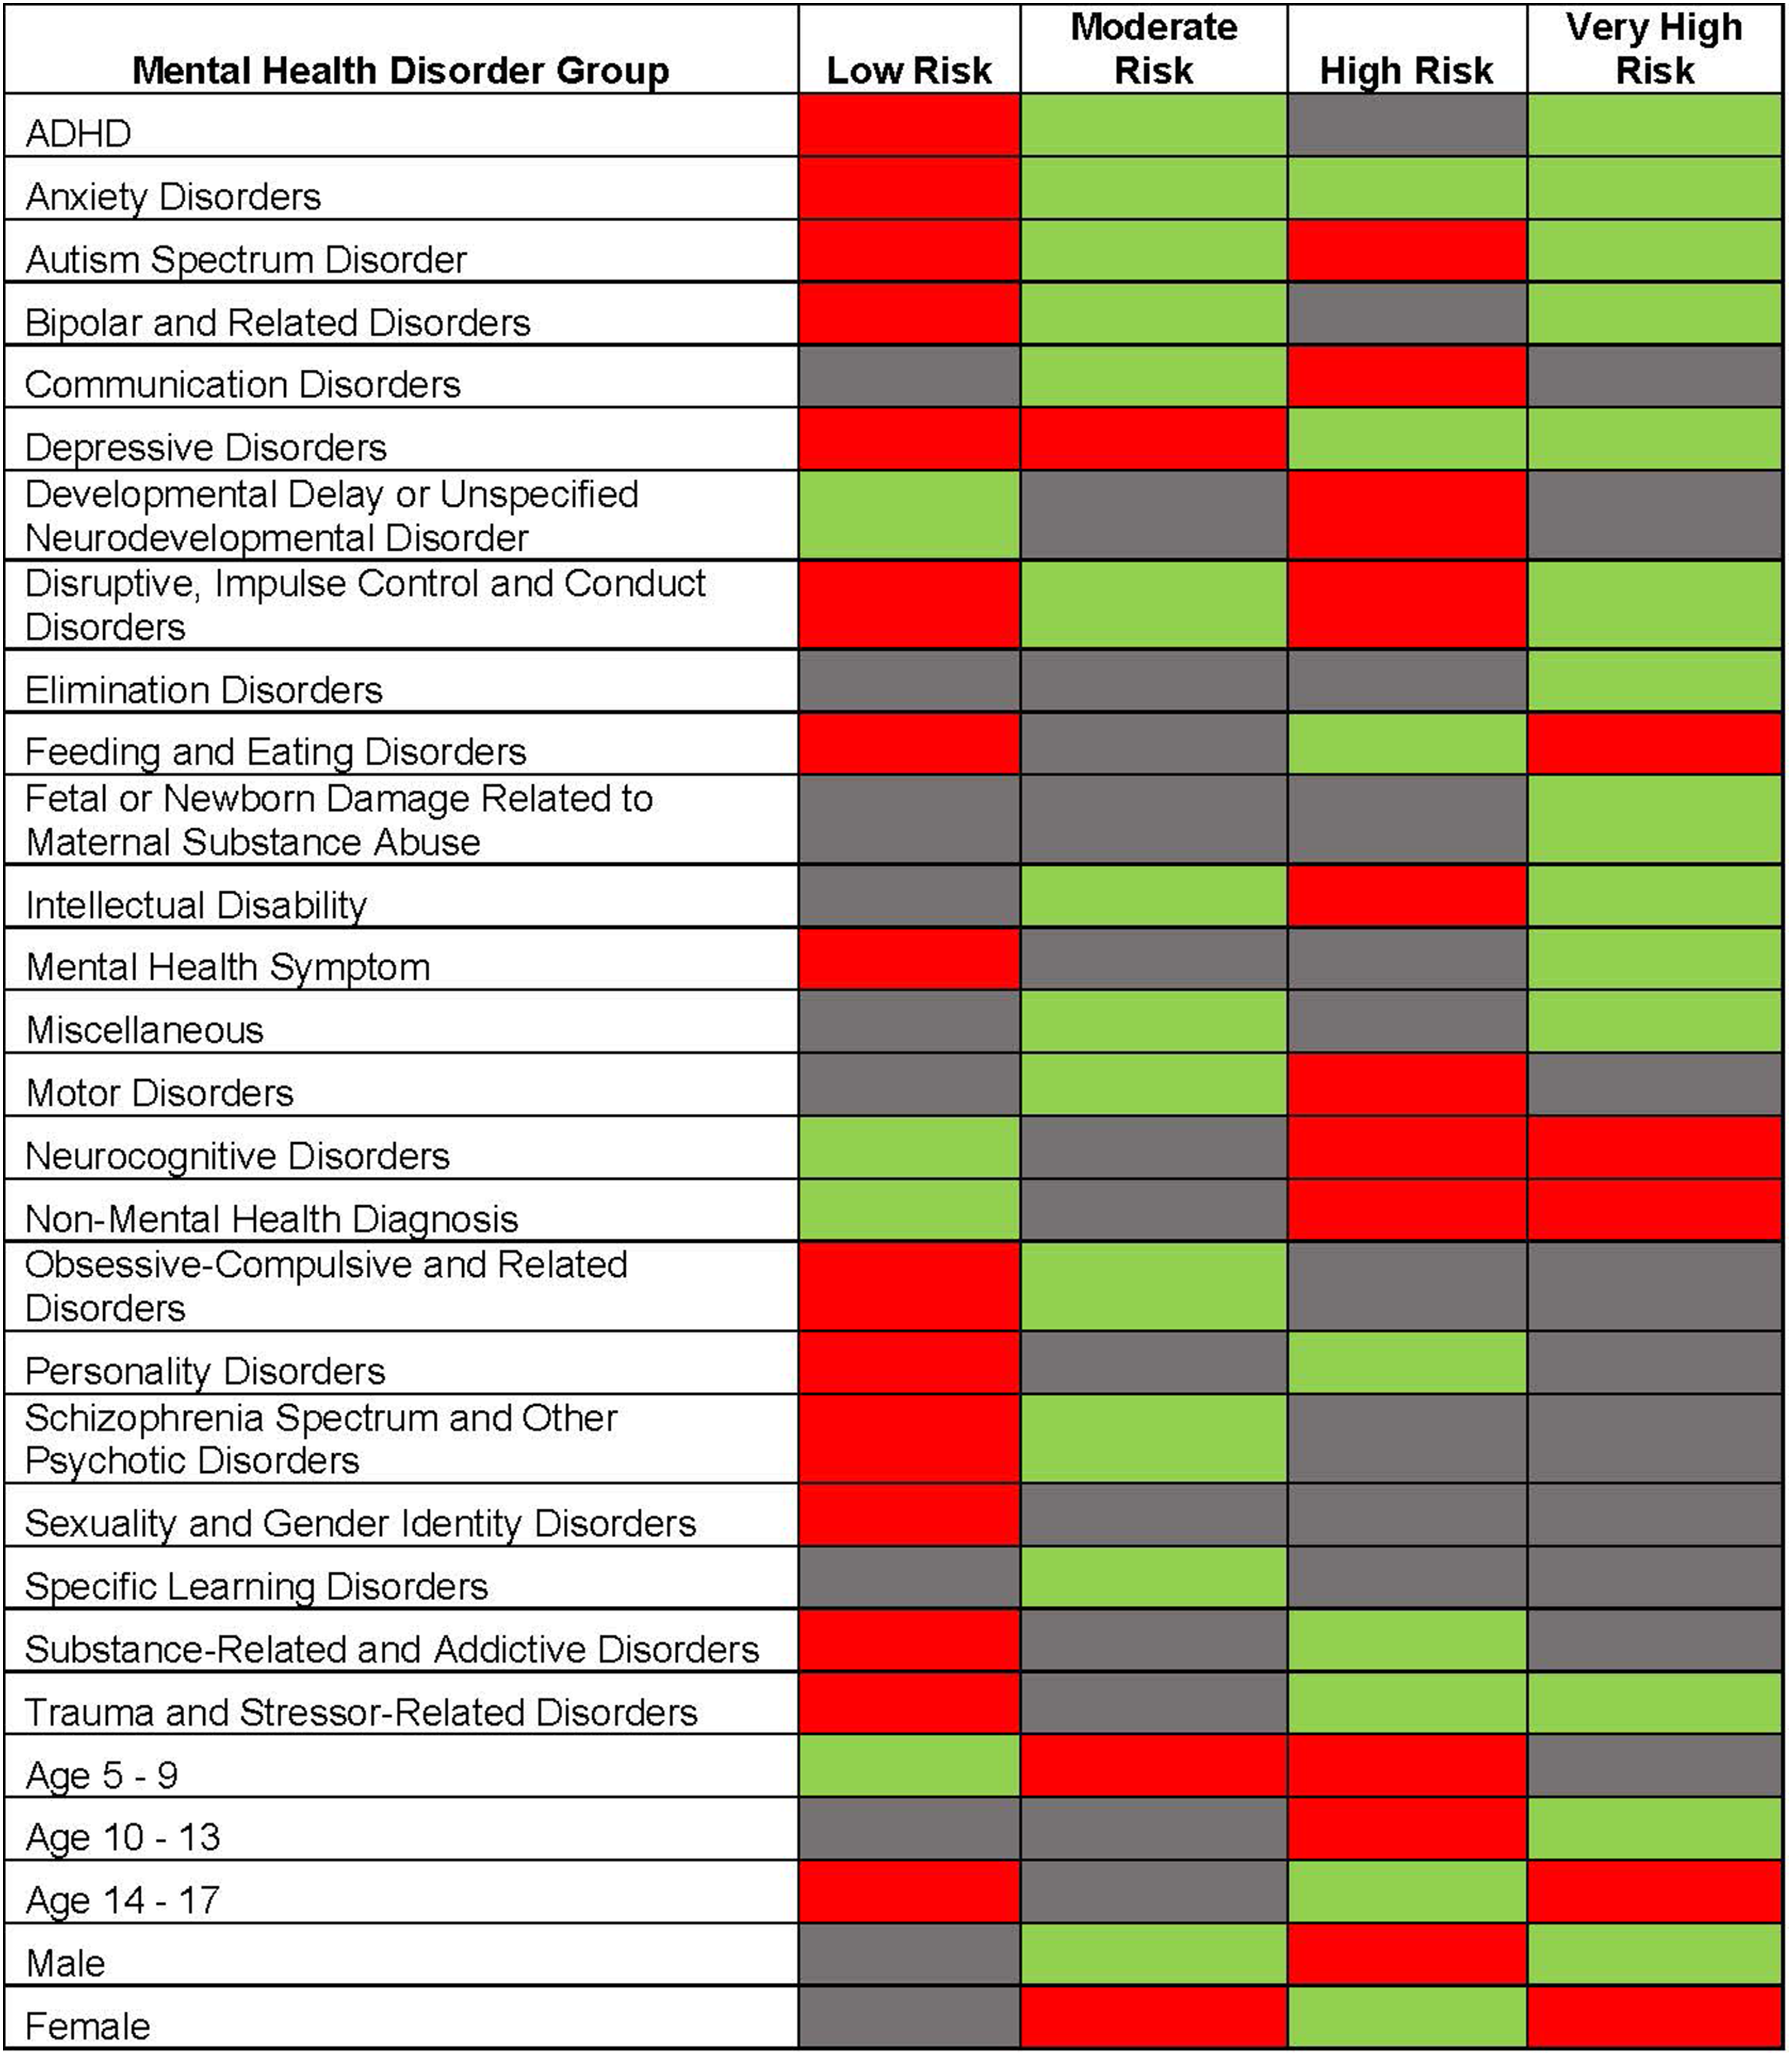
From: Characteristics Associated With Serious Self-Harm Events in Children and Adolescents
Pediatrics. 2023;151(6). doi:10.1542/peds.2022-059817
Figure Legend:
Green indicates that the presence of the covariate was significant while red indicates the absence of the covariate was significant. Gray indicates that the mental health disorder group has no significant impact on that profile. Accidental or undetermined poisoning, dissociative disorders, sleep-wake disorders, somatic symptom and related disorders, maternal mental illness or substance abuse during pregnancy, and substance abuse related medical illness are not depicted in the table below because they had no significant impact on any of the profiles.
Date of Download: 7/20/2023
Copyright © 2023 American Academy of Pediatrics. All rights reserved.

