Slide 1
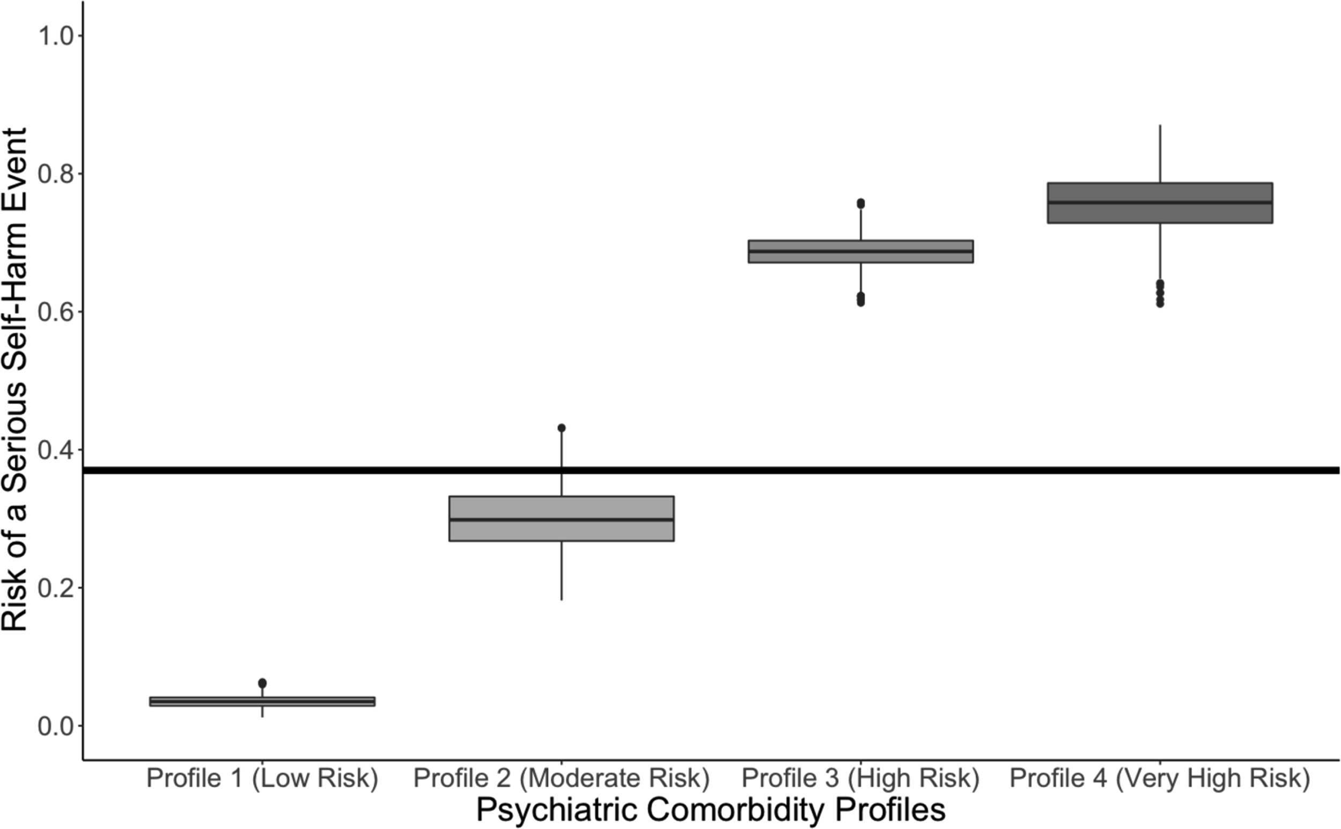
From: Characteristics Associated With Serious Self-Harm Events in Children and Adolescents
Pediatrics. 2023;151(6). doi:10.1542/peds.2022-059817
Figure Legend:
Risk for a serious self-harm event stratified by profile. Bootstrap resampling was used to generate 1000 data points of risk for each profile. The risk was the posterior probability, which was used to generate the posterior means ORs.
Date of Download: 7/20/2023
Copyright © 2023 American Academy of Pediatrics. All rights reserved.

